Slide 1
Do State Tobacco-21 Laws Work?
Benjamin Hansen, University of Oregon, NBER & IZA
Drew McNichols, Amazon
Joseph J. Sabia, Center for Health Economics & Policy Studies
Calvin Bryan, Colorado State University

Slide 2
Disclosures
This research was supported by the Center for Health Economics & Policy Studies (CHEPS) at San Diego State University, which included research support for a postdoctoral fellow and graduate students from the Troesh Family Foundation and the Charles Koch Foundation.
The research team has no conflicts of interest to report.

Slide 3
Motivation
Tobacco use is leading cause of preventable death in US
480,000 deaths per year (CDC 2019)
Linked to increased risk of heart diseases, cancers (lung, liver, head, colon), diminished respiratory function, and stroke (DHHS 2019)
Substantial social costs of tobacco use
$200 billion per year in direct health care costs
Over $7 billion in external costs (secondhand, third hand) (DHHS 2014)
Majority of adult smokers initiate as youths (Everett 1999; Gilliand 2006)
Mean age of initiation: 15.3 (CDC 2014)
From a social welfare perspective why do we care about young adults?
Youth smokers are more likely to have time-inconsistent preferences and give insufficient weight to future addiction costs (Crettez and Deloche 2020)
Youths more often fail to account for external costs of private consumption (O’Donoghue and Rabin 2001)

Slide 4
Policy Strategies to Curb Youth Smoking
Clean indoor air laws (Chaloupka and Eriksen 2008)
Restrictions or bans on tobacco advertising (Schroeder 2004)
Increases in excise taxes on cigarettes (Carpenter and Cook 2008)
Evidence that recent tax increases have been less effective at deterring youth smoking than they were in the past (Hansen et al. 2017; Anderson et al. 2020; Carpenter and Simone 2020)
Regulation of electronic cigarette (e-cigarette) market
Explosion in the market for electronic cigarettes (e-cigarettes) as an alternative source of nicotine for youths
Raising the minimum legal purchasing age to 18
Imposition of electronic cigarette taxes
Evidence that there may be unintended consequences of such policies for both adults (Pesko et al. 2019) and youths (Abouk et al. 2021) due to tobacco product substitution

Slide 5
Tobacco-21 Laws
T-21 laws raise the minimum legal purchasing age (MLPA) for all tobacco products (i.e., cigarettes, chew, cigars, e-cigarettes) to age 21
Could circumvent problems with tobacco product substitution
Laws enjoy the support of American Medical Association (Parks 2016), American Academy of Pediatrics (2015), American Public Health Association (Lowry 2019), Institutes of Medicine (2015), American Heart Association (AHA 2019), American Cancer Society (ACS 2020), American Lung Association (ALA 2020)
Wide public support for T-21 laws
74% of all adults, including 64% of smokers and 74% of former smokers

Slide 6
Ages 18-to-20 are critical for addiction
While most adult smokers began experimenting with tobacco prior to age 14 (CDC 2020), ages 18 to 20 seem to be a critical time on the path from experimental use from addiction
Only 46% of adult smokers became everyday smokers before age 18 while nearly 80% did so before age 21 (DHHS 2014)
T-21 laws could be an effective strategy to curtail everyday use and increase successful quit attempts (Khudar et al. 1999)

Slide 7
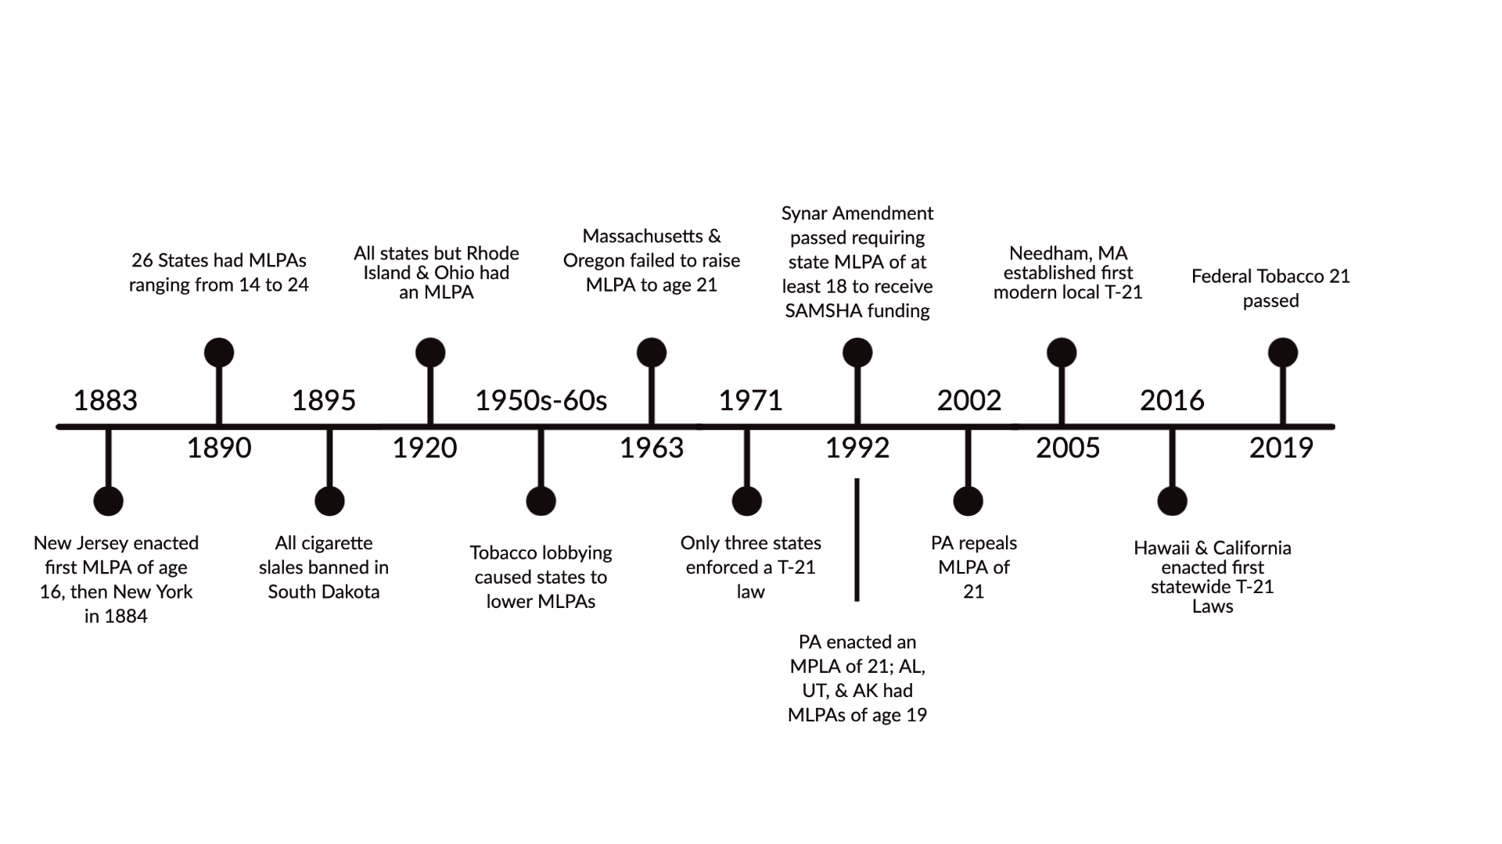
Timeline of Tobacco MLPA Laws
Sources: Alston et al. 2002; Appolonio and Glants (2016)

Slide 8
Toward Statewide T-21 Laws
Local Mandates
While over 500 municipalities raised their MLPAs throughout the 2000s and 2010s, the localized nature of laws left young adults with a (relatively) low cost means of evasion (Friedman and Wu 2019)
One of the rationale for statewide or even nationwide T-21 laws
Between 2016 and 2019, 16 states and the District of Columbia adopted “statewide” T-21 laws
Opponents argue that T-21 laws will:
Be ineffective (Males 2016)
Limit freedom (Bengal 2017), perhaps of those who are rationally addicted
Unfair encroachment on freedoms of those able to serve in war, vote, make other important decisions
Advocates argue that T-21 laws will:
Improve public health (NAM argued national T-21 law will reduce premature deaths by 223,000, lung cancer deaths by 50,000, and reduce years of life cut short for those born 2000-2019)
Statewide laws will avoid spillovers, both in terms of tobacco product substitution and evasion
Reduce tobacco use among those under age 18
Over three-quarters of 16-17-year-old smokers obtain cigarettes via the social market (i.e., third party purchase, bumming, borrowing, stealing, or another way), including 18yo peers
Role modeling effects
Fake IDs more difficult to pull off for 16-17 year-olds

Slide 9
Spillover argument echoed by proponents and opponents
“The most serious threat involves the use of vaping devices for teens under 18 years old. Far too often, 18-year-olds, who are still in high school and can legally buy vaping devices, are sharing them with their younger classmates and the problem isn’t only high schoolers. In 2018, there was a nearly 50% increase of middle school students vaping throughout the country. Raising the age limit to 21 presents fewer opportunities for children to get their hands on vaping devices.”
- Senate Minority Leader Mitch McConnell (R- Kentucky, 2019)
“Raising the legal minimum wage for cigarette purchase to 21 could gut our key young adult market (17-20) where we sell about 25 billion cigarettes and enjoy a 70 percent market share.”
- Philip Morris Strategy Brief (1986)

Slide 10
Prior Research on T-21 Laws
Studies of local (municipal) T-21 laws
Schneider et al. 2016; Silver et al. 2016; Friedman et al. 2019; Friedman and Wu 2020
Key insight: Spillovers may be important
If T-21 policy only partially covered a metropolitan/micropolitan statistical area, the estimated effect of T-21 on smoking was about 60% smaller
Case studies of state T-21 laws
Pennsylvania (Yan 2014)
Smoking among pregnant mothers declines (uses an RDD around age 21)
California (Schiff et al. 2020; Boettinger and White 2020)
Before-after and synthetic control estimates
Note that California’s law enacted with a bundle of taxes

Slide 11
Contributions
First study to examine impact of statewide T-21 laws adopted nationwide
First to explore spillover effects of statewide T-21 laws on minors, who rely heavily on the social market for cigarettes
Examine the effects of statewide T-21 laws on electronic cigarette use (at a time when JuuL explodes on the market)
Descriptively explore effects of statewide T-21 laws on teenagers’ use of the social market for e-cigarettes
First to examine spillover effects of statewide T-21 laws on alcohol and marijuana use

Slide 12
Data
Behavioral Risk Factor Surveillance System (BRFSS) Survey, 2009-2019
Treatment group focuses on approximately 95,000 individuals ages 18-20
Cigarette Consumption Measures (0/1)
Smoking Participation
= 1 if smoked at least 100 cigarettes in lifetime and now smoke everyday or some days; = 0 otherwise
12.3 percent of 18-20-year-olds were current smokers
Everyday Smoking
= 1 if smoked at least 100 cigarettes in lifetime and now smoke everyday; = 0 otherwise
7.2 percent of 18-20-year-olds were everyday smokers
Quit
= 1 if smoked at least 100 cigarettes in lifetime and was not a current smoker; = 0 if smoked at least 100 cigarettes in lifetime and was a current smoker
24.9 percent of 18-20-year-olds were “successful” quitters

Slide 13
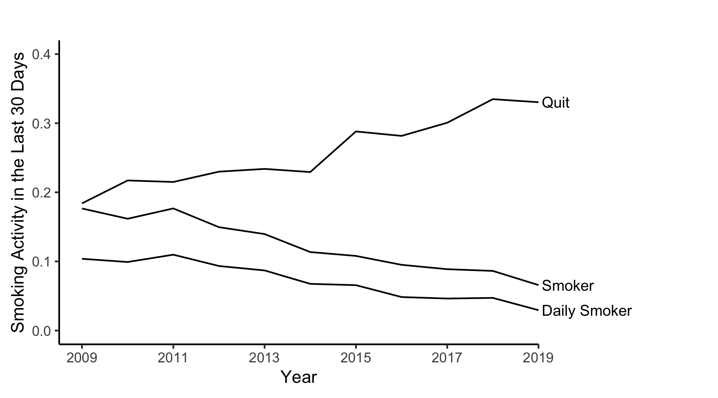
Trends in Smoking in BRFSS

Slide 14
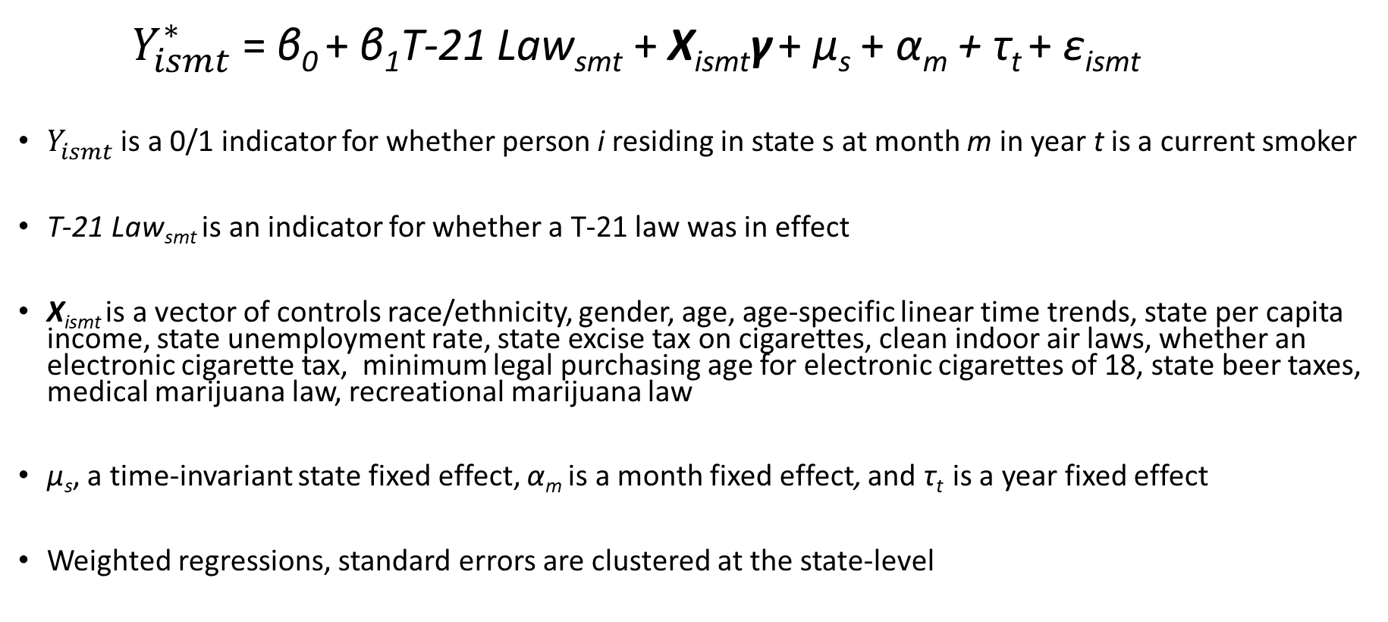
Empirical Approach: “TWFE” Logit
$Y_{ismt}^{∗}$ = β₀ + β₁T-21 Law_{smt} + X_{ismt}γ + μ_{s} + α_{m} + τ_{t} + ε_{ismt}
$Y_{ismt}^{}$ is a 0/1 indicator for whether person i residing in state s at month m in year t is a current smoker
T-21 Law_{smt} is an indicator for whether a T-21 law was in effect
X_{ismt} is a vector of controls race/ethnicity, gender, age, age-specific linear time trends, state per capita income, state unemployment rate, state excise tax on cigarettes, clean indoor air laws, whether an electronic cigarette tax, minimum legal purchasing age for electronic cigarettes of 18, state beer taxes, medical marijuana law, recreational marijuana law
μ_{s}, a time-invariant state fixed effect, α_{m} is a month fixed effect, and τ_{t} is a year fixed effect
Weighted regressions, standard errors are clustered at the state-level

Slide 15
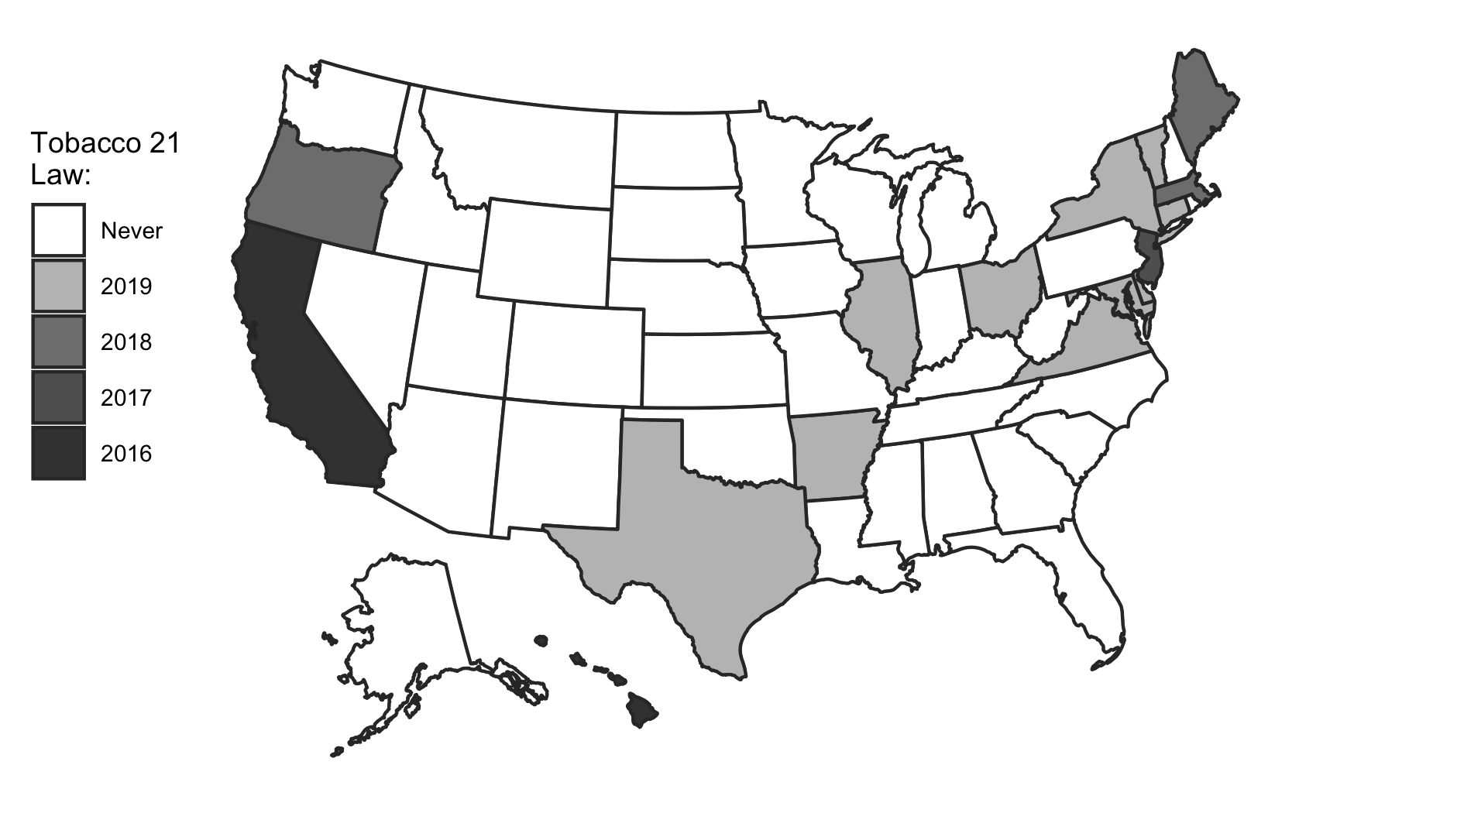
Statewide T-21 Policy Variation

Slide 16
“TWFE” Logit Estimates, Ages 18 to 20
 | Panel I: Smoking Participation
Tobacco 21 Law | -0.025** | -0.029** | -0.039***
 | (0.012) | (0.012) | (0.011)
Pre-Treat DV Mean | 0.115 | 0.115 | 0.115
 | Panel II: Everyday Smoking
Tobacco 21 Law | -0.016** | -0.020** | -0.024***
 | (0.008) | (0.008) | (0.008)
Pre-Treat DV Mean | 0.064 | 0.064 | 0.064
 | Panel III: Quit
Tobacco 21 Law | 0.041 | 0.046 | 0.053
 | (0.053) | (0.053) | (0.058)
Pre-Treat DV Mean | 0.259 | 0.259 | 0.259
Socioecon & Cigarette Policy Controls? | Y | Y | Y
E-cigarette Polices? | N | Y | Y
Alcohol and Marijuana Policies? | N | N | Y
***Significant at 1% level **Significant at 5% level *Significant at 10% level

Slide 17
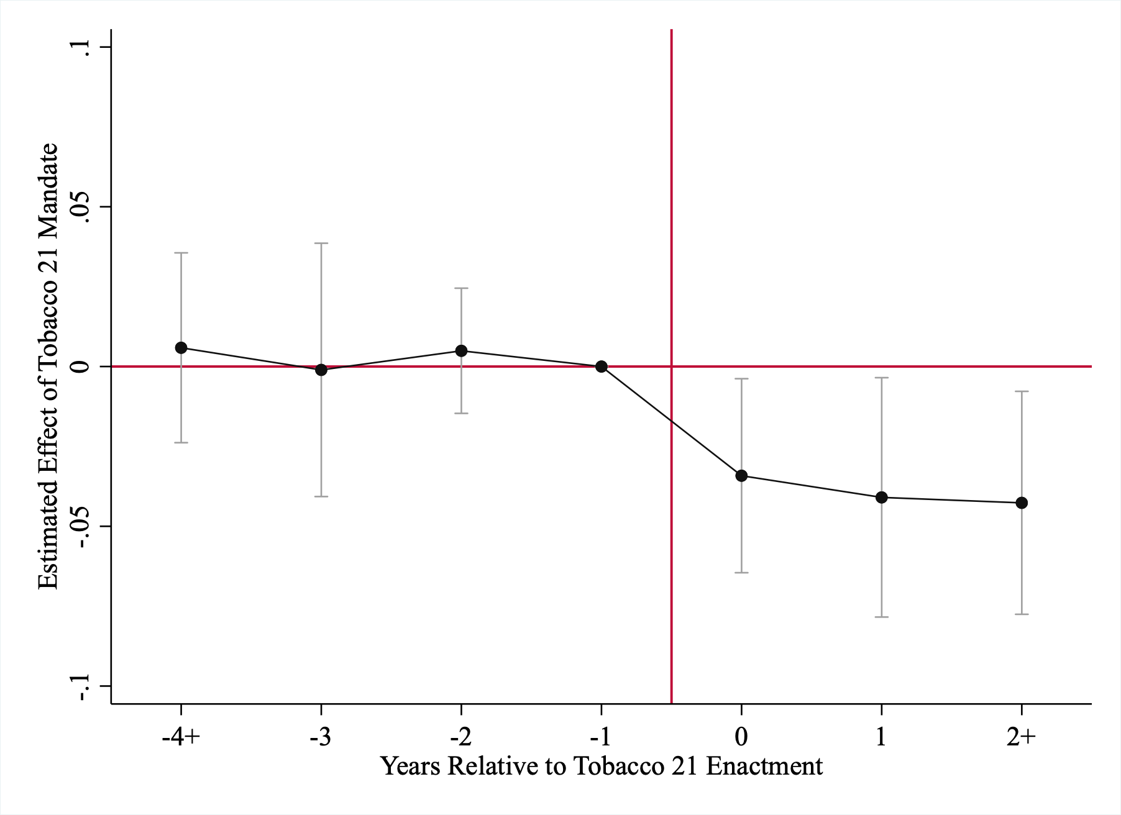
Event-Study Analyses

Slide 18
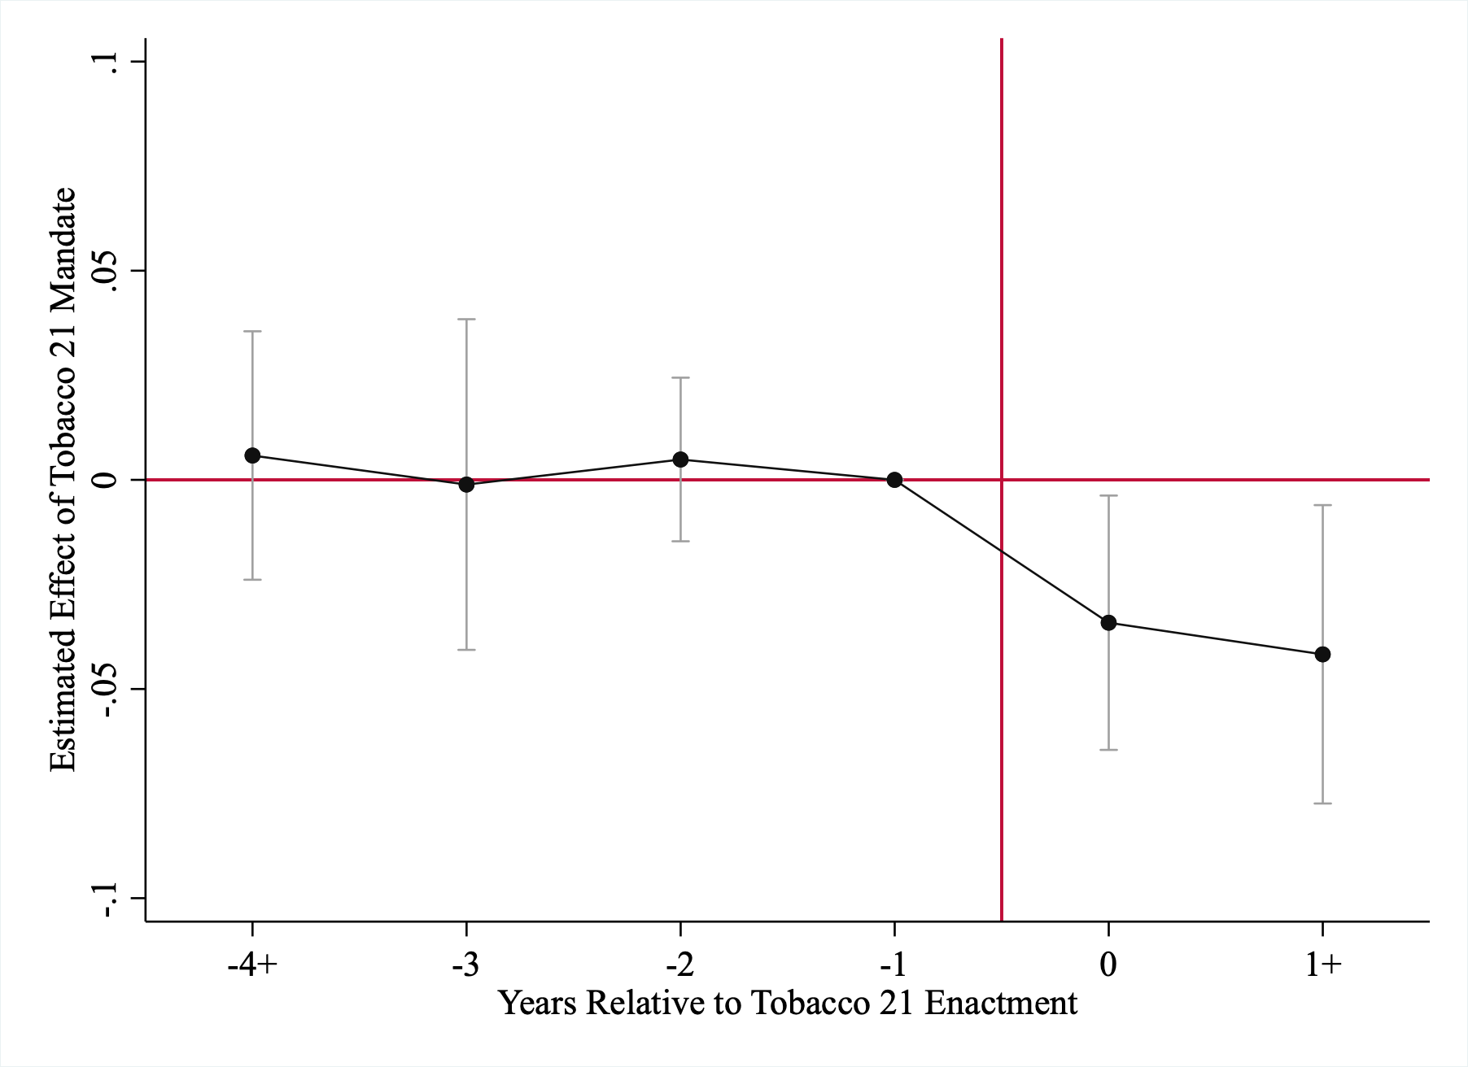
“More Balanced” TWFE Event Study

Slide 19
Stacked Difference-in-Differences
“TWFE” logit estimates may be biased in the presence of heterogeneous dynamic treatment effects (Sun and Abraham 2021; Goodman-Bacon 2021)
We focus on a more closely balanced panel (in event time) of 4 years of leads and up to 1 year of lagged effects
Each stack comprised of states that implemented a T-21 law in the same month-year and counterfactual states that had never implemented a T-21 law
Also explored use of “not yet adopting” states, with a similar pattern of results
Include stack-specific state and time effects as well as the controls described above
Weighted using product of BRFSS sample weights and number of states in each stack

Slide 20
“Stacked DD” Logit Estimates, Ages 18 to 20
 | Panel I: Smoking Participation
Tobacco 21 Law | -0.038*** | -0.039*** | -0.037***
 | (0.010) | (0.010) | (0.009)
Pre-Treat DV Mean | 0.083 | 0.083 | 0.083
 | Panel II: Everyday Smoking
Tobacco 21 Law | -0.012 | -0.013* | -0.012*
 | (0.007) | (0.007) | (0.007)
Pre-Treat DV Mean | 0.040 | 0.040 | 0.040
 | Panel III: Quit
Tobacco 21 Law | 0.010 | 0.012 | 0.004
 | (0.072) | (0.072) | (0.073)
Pre-Treat DV Mean | 0.305 | 0.305 | 0.305
Socioecon & Cigarette Policy Controls? | Y | Y | Y
E-cigarette Polices? | N | Y | Y
Alcohol and Marijuana Policies? | N | N | Y
***Significant at 1% level **Significant at 5% level *Significant at 10% level

Slide 21
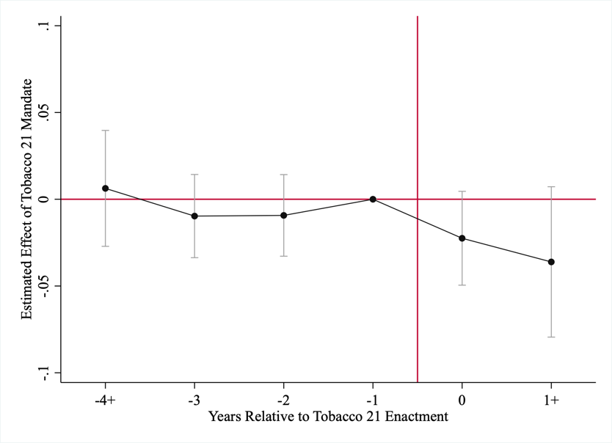
“Stacked DD” Event Study

Slide 22
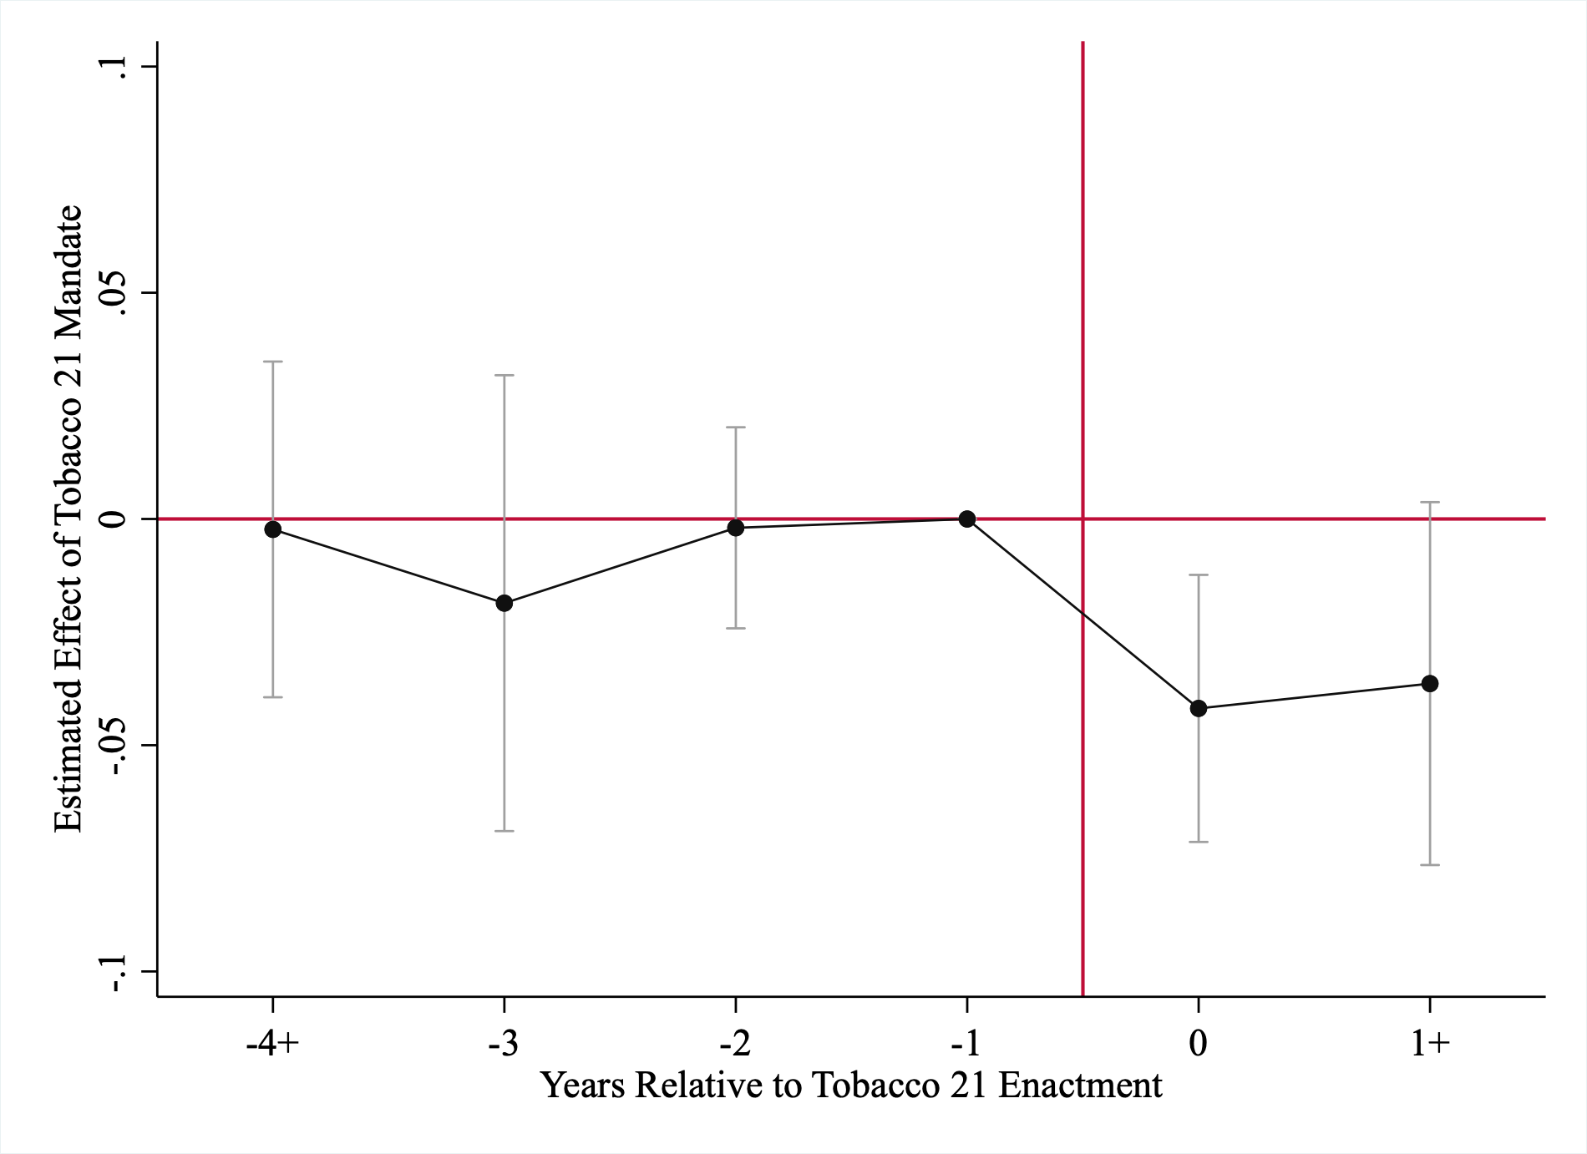
Unbalanced Stacked DD event study

Slide 23
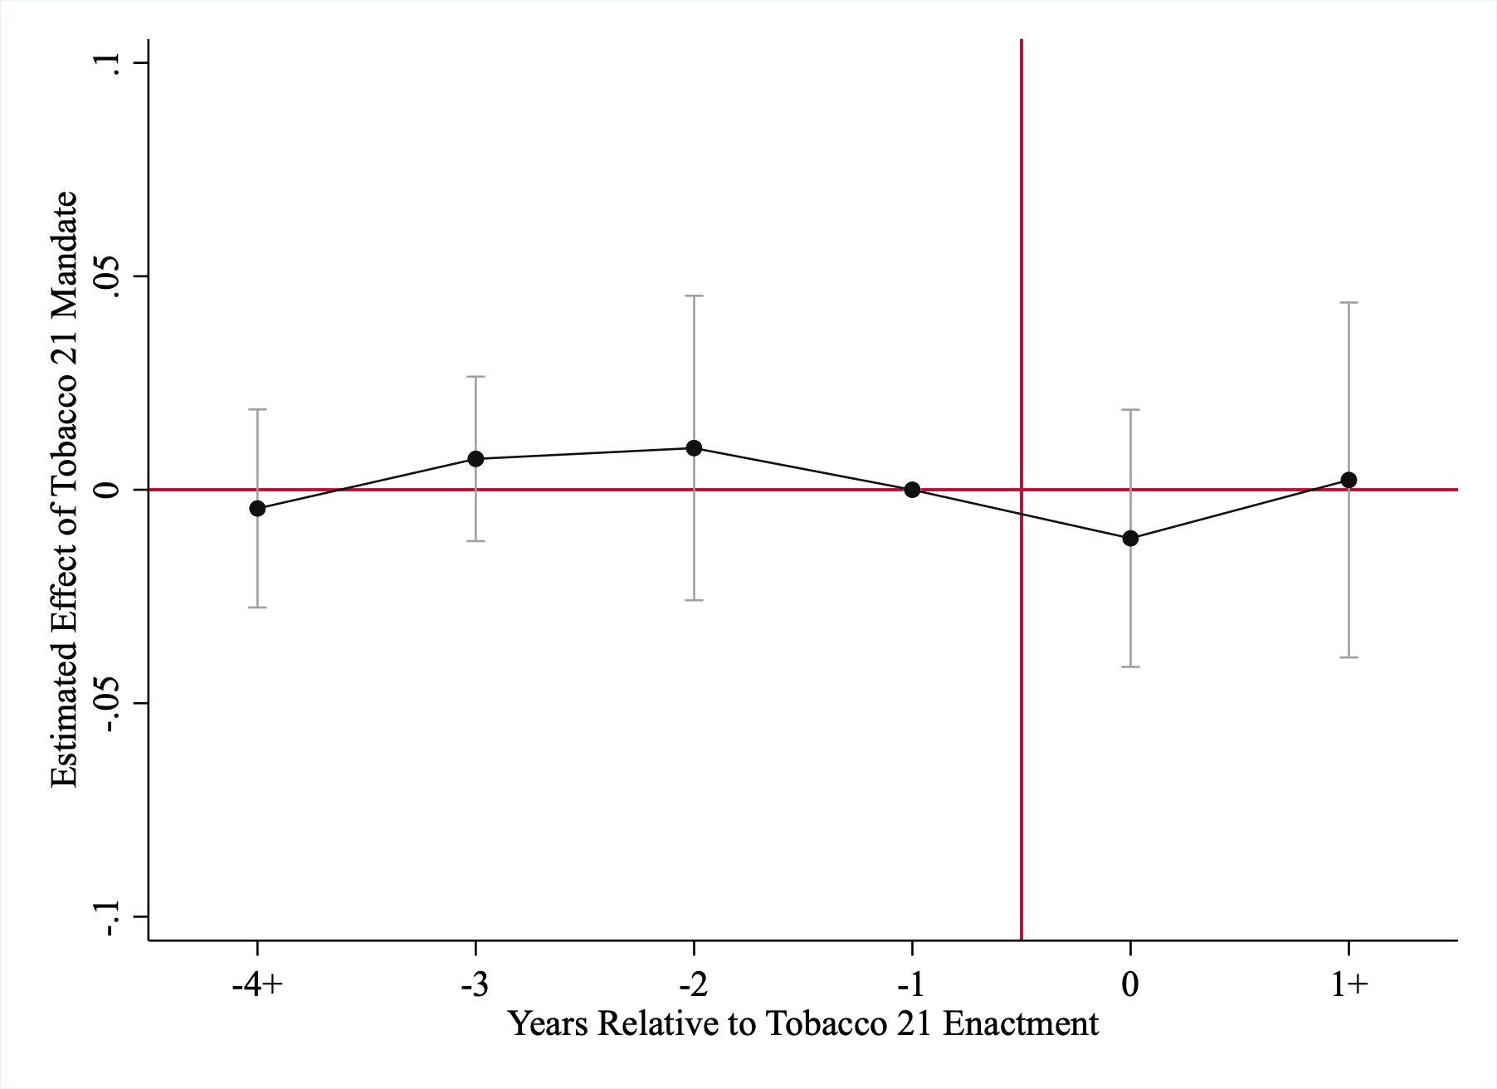
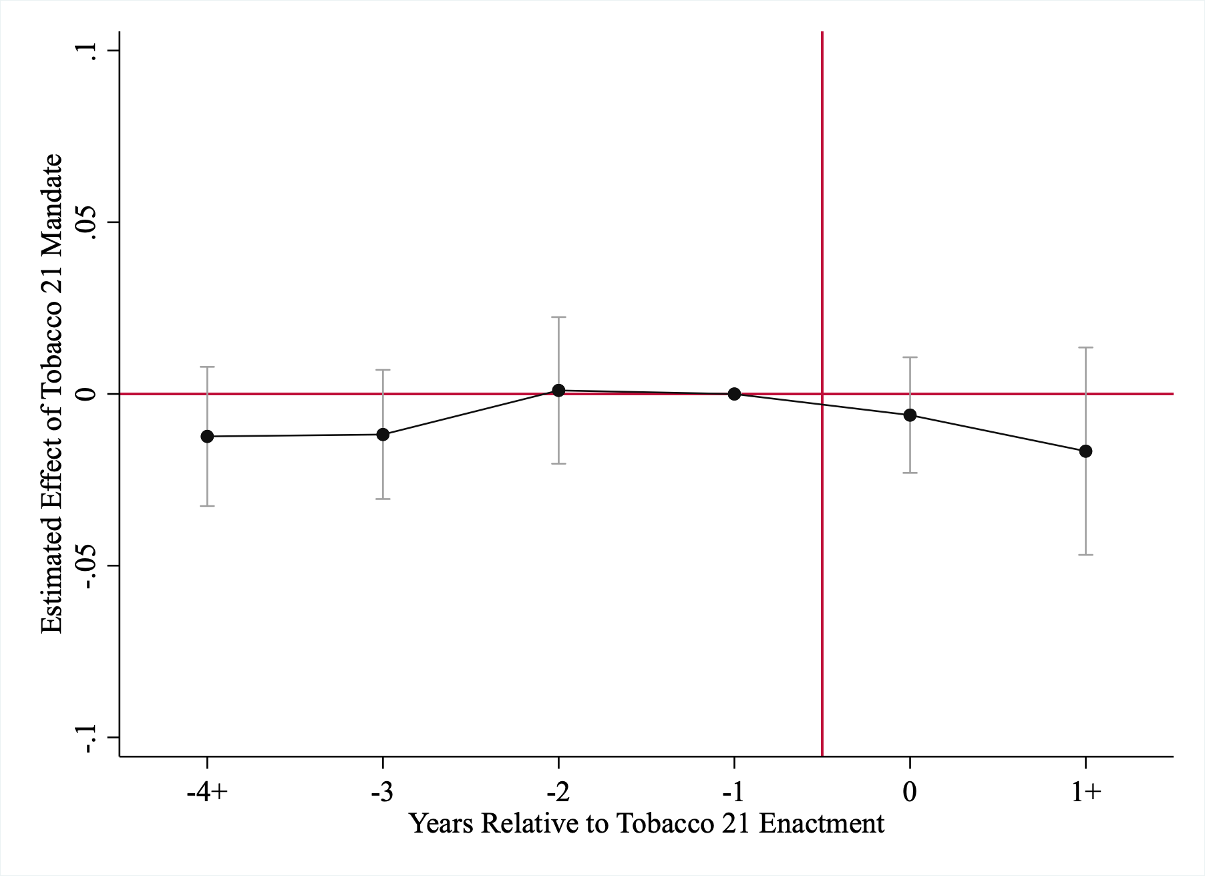
Older Individuals (Less Affected)
Ages 21-to-23
Ages 24-to-28

Slide 24
“Triple Differences” Logit Estimates, Ages 18-20 vs Ages 21-23
 | Panel I: Smoking Participation
Tobacco 21 Law | -0.007 | -0.001
 | (0.012) | (0.014)
Tobacco 21 Law *Age 18-to-20 | -0.040*** | -0.024**
 | (0.012) | (0.010)
Pre-Treat DV Mean | 0.115 | 0.115
 | Panel II: Everyday Smoking
Tobacco 21 Law | 0.002 | 0.011
 | (0.009) | (0.009)
Tobacco 21 Law *Age 18-to-20 | -0.032*** | -0.016*
 | (0.012) | (0.009)
Pre-Treat DV Mean | 0.064 | 0.064
 | Panel III: Quit
Tobacco 21 Law | 0.032 | -0.057
 | (0.031) | (0.039)
Tobacco 21 Law *Age 18-to-20 | 0.025 | 0.045
 | (0.042) | (0.058)
Pre-Treat DV Mean | 0.259 | 0.259
State-by-Year FE? | N | Y

Slide 25

Event-Study Analysis of Triple-Difference

Slide 26
Sensitivity of Estimates to Use of Birth Cohort Rather than Age to Define Treatment
 | Smoking Participation | Everyday Smoking | Quit
Tobacco 21 Law | -0.011 | -0.010 | 0.017
 | (0.008) | (0.006) | (0.023)
Tobacco 21 Law * Affected Birth Cohort | -0.039* | -0.028 | -0.027
 | (0.022) | (0.018) | (0.019)
Pre-Treat DV Mean | 0.115 | 0.064 | 0.259

Slide 27
Including Local Laws in Definition of Treatment
 | Smoking Participation | Everyday Smoking | Quit
 | Panel I: Including Local T-21 Laws in Treatment
Any Tobacco 21 Law | -0.033*** | -0.006 | 0.037
 | (0.012) | (0.010) | (0.045)
Pre-Treat DV Mean | 0.115 | 0.064 | 0.259
 | Panel II: Separating State and Local T-21 Laws
Statewide Tobacco 21 Law | -0.041*** | -0.021 | 0.052
 | (0.012) | (0.009) | (0.057)
Local Tobacco 21 Law | -0.012 | 0.029 | -0.007
 | (0.023) | (0.019) | (0.056)
Pre-Treat DV Mean | 0.115 | 0.064 | 0.259

Slide 28
Do border state T-21 policies matter?
 | Smoking Participation | Everyday Smoking | Quit
Tobacco 21 Law | -0.038*** | -0.019** | 0.066
 | (0.011) | (0.009) | (0.056)
Tobacco 21 Law * Border State T-21 Law | -0.004 | -0.022 | -0.055
 | (0.016) | (0.016) | (0.040)
Pre-Treat DV Mean | 0.115 | 0.064 | 0.259

Slide 29
Electronic Cigarettes and Age Heterogeneity
 | Age 18 | Ages 19-to-20
 | Panel I: Smoking Participation
Tobacco 21 Law | -0.074*** | -0.027**
 | (0.017) | (0.014)
Pre-Treat DV Mean | 0.094 | 0.127
 | Panel II: E-Cigarette Participation
Tobacco 21 Law | -0.080*** | 0.012
 | (0.024) | (0.033)
Pre-Treat DV Mean | 0.095 | 0.105

Slide 30
Demographic Heterogeneity in Effects of T-21 Laws on Smoking Participation
 | Male | Female | White | Black | Other | HSD | No HSD | Below Poverty Line | Below Poverty Line | Above Poverty Line | Above Poverty Line
Tobacco 21 Law | -0.034** | -0.045** | -0.056** | -0.064** | -0.015 | -0.033*** | -0.084** |  | -0.053** |  | -0.034***
 | (0.015) | (0.018) | (0.024) | (0.032) | (0.019) | (0.010) | (0.034) |  | (0.024) |  | (0.010)
Pre-Treat DV Mean | 0.137 | 0.090 | 0.146 | 0.084 | 0.088 | 0.101 | 0.193 |  | 0.152 |  | 0.101

Slide 31
State Youth Risk Behavior Surveys
State Youth Risk Behavior Surveys, 2009-2019
Surveys designed to be representative of risky behaviors of state high school students
Can be weighted using SEER to produce nationally representative estimates
Explore the impact of T-21 laws on 18-year-old U.S. high school students who are directly bound by mandates
Two big advantages
Examine spillovers to the youths who depend heavily on social market for tobacco (16-to-17-year-olds in same high schools)
Descriptively explore whether T-21 affects usual sources of electronic cigarettes
Outcomes
Smoking Participation, Frequent Smoking (20 or more days in last month), Everyday Smoking

Slide 32
“TWFE” Logit Estimates, State YRBS (18-year-olds)
 | Panel I: Smoking Participation
Tobacco 21 Law | -0.021 | -0.030* | -0.025
 | (0.017) | (0.016) | (0.016)
Pre-Treat DV Mean | 0.209 | 0.209 | 0.209
 | Panel II: Frequent Smoking
Tobacco 21 Law | -0.069** | -0.069*** | -0.065***
 | (0.027) | (0.026) | (0.024)
Pre-Treat DV Mean | 0.077 | 0.077 | 0.077
 | Panel III: Everyday Smoking
Tobacco 21 Law | -0.051** | -0.051** | -0.048*
 | (0.026) | (0.026) | (0.025)
Pre-Treat DV Mean | 0.056 | 0.056 | 0.056
Socioecon & Cigarette Policy Controls? | Y | Y | Y
E-cigarette Polices? | N | Y | Y
Alcohol and Marijuana Policies? | N | N | Y

Slide 33
“Stacked DD” Logit Estimates, YRBS (18-year-olds)
 | Panel I: Smoking Participation
Tobacco 21 Law | -0.018 | -0.022 | -0.009
 | (0.022) | (0.021) | (0.019)
Pre-Treat DV Mean | 0.197 | 0.197 | 0.197
 | Panel II: Frequent Smoking
Tobacco 21 Law | -0.036* | -0.036* | -0.034*
 | (0.019) | (0.019) | (0.039)
Pre-Treat DV Mean | 0.073 | 0.073 | 0.073
 | Panel III: Everyday Smoking
Tobacco 21 Law | -0.038* | -0.039* | -0.039
 | (0.023) | (0.023) | (0.024)
Pre-Treat DV Mean | 0.054 | 0.054 | 0.054
Socioecon & Cigarette Policy Controls? | Y | Y | Y
E-cigarette Polices? | N | Y | Y
Alcohol and Marijuana Policies? | N | N | Y

Slide 34
Heterogeneity in Effects by Gender and Race
 | Male | Female |  | White | Black
 | Panel I: Smoking Participation
Tobacco 21 Law | -0.055** | 0.009 | -0.043 |  | -0.066*
 | (0.023) | (0.024) | (0.031) |  | (0.040)
Pre-Treat DV Mean | 0.249 | 0.166 | 0.252 |  | 0.130
 | Panel II: Frequent Smoking
Tobacco 21 Law | -0.101** | -0.021 | -0.113** | -0.113** |  | -0.045
 | (0.041) | (0.031) | (0.052) | (0.052) |  | (0.052)
Pre-Treat DV Mean | 0.096 | 0.056 | 0.112 | 0.112 |  | 0.051
 | Panel III: Everyday Smoking
Tobacco 21 Law | -0.072** | -0.021 |  | -0.074* |  | -0.076*
 | (0.034) | (0.049) |  | (0.043) |  | (0.043)
Pre-Treat DV Mean | 0.070 | 0.041 |  | 0.083 |  | 0.040

Slide 35
Spillover Effects to 16-to-17 Year-Olds
 | All | Male | Female | White | Black
 | Panel I: Smoking Participation
Tobacco 21 Law | -0.028* | -0.028 | -0.028** | -0.035** | -0.024
 | (0.014) | (0.020) | (0.014) | (0.017) | (0.027)
Pre-Treat DV Mean | 0.135 | 0.151 | 0.118 | 0.164 | 0.068
 | Panel II: Frequent Smoking
Tobacco 21 Law | -0.011 | -0.012 | -0.014 | -0.053** | -0.028
 | (0.008) | (0.015) | (0.009) | (0.027) | (0.029)
Pre-Treat DV Mean | 0.042 | 0.051 | 0.034 | 0.060 | 0.018
 | Panel III: Everyday Smoking
Tobacco 21 Law | -0.005 | -0.006 | -0.005 | -0.040** | -0.006
 | (0.005) | (0.011) | (0.007) | (0.019) | (0.025)
Pre-Treat DV Mean | 0.031 | 0.038 | 0.024 | 0.045 | 0.014

Slide 36
What about Effects of 14-to-15-Year-Olds?
 | Panel I: Smoking Participation
Tobacco 21 Law | -0.006 | -0.010 | -0.009
 | (0.008) | (0.009) | (0.009)
Pre-Treat DV Mean | 0.079 | 0.079 | 0.079
 | Panel II: Frequent Smoking
Tobacco 21 Law | -0.007 | -0.009 | -0.007
 | (0.007) | (0.007) | (0.007)
Pre-Treat DV Mean | 0.019 | 0.019 | 0.019
 | Panel III: Everyday Smoking
Tobacco 21 Law | -0.003 | -0.004 | -0.002
 | (0.007) | (0.007) | (0.006)
Pre-Treat DV Mean | 0.013 | 0.013 | 0.013
Socioecon & Cigarette Policy Controls? | Y | Y | Y
E-cigarette Polices? | N | Y | Y
Alcohol and Marijuana Policies? | N | N | Y

Slide 37
E-Cigarette Consumption
 |  | (1) | (2) | (3) |  | (4) | (5)
 |  | 18-Year-Olds |  |  |  | 16-to-17-Year-Olds
 |  | Panel I: E-Cigarette Participation
Tobacco 21 Law |  | -0.081* (0.042) 0.243 | -0.117** (0.047) 0.176 | -0.063 (0.047) 0.176 |  | 0.090 | 0.083
 |  | (0.042) | (0.047) | (0.047) |  | (0.062) | (0.064)
Pre-Treat DV Mean |  | 0.243 | 0.176 | 0.176 |  | 0.126 | 0.126
 |  | Panel II: Frequent E-Cigarette Use
Tobacco 21 Law |  | -0.053* | -0.069 | -0.073* |  | 0.029 | 0.027
 |  | (0.030) | (0.042) | (0.041) |  | (0.037) | (0.039)
Pre-Treat DV Mean |  | 0.054 | 0.048 | 0.048 |  | 0.024 | 0.024
 |  | Panel III: Everyday E-Cigarette Use
Tobacco 21 Law |  | -0.052** | -0.058 | -0.067* |  | 0.034 | 0.029
 |  | (0.024) | (0.036) | (0.037) |  | (0.035) | (0.035)
Pre-Treat DV Mean |  | 0.043 | 0.037 | 0.037 |  | 0.014 | 0.014
Years |  | 2015-19 | 2017-19 | 2017-19 |  | 2017-19 | 2017-19
Policy Controls? |  | Y | N | Y |  | N | Y

Slide 38
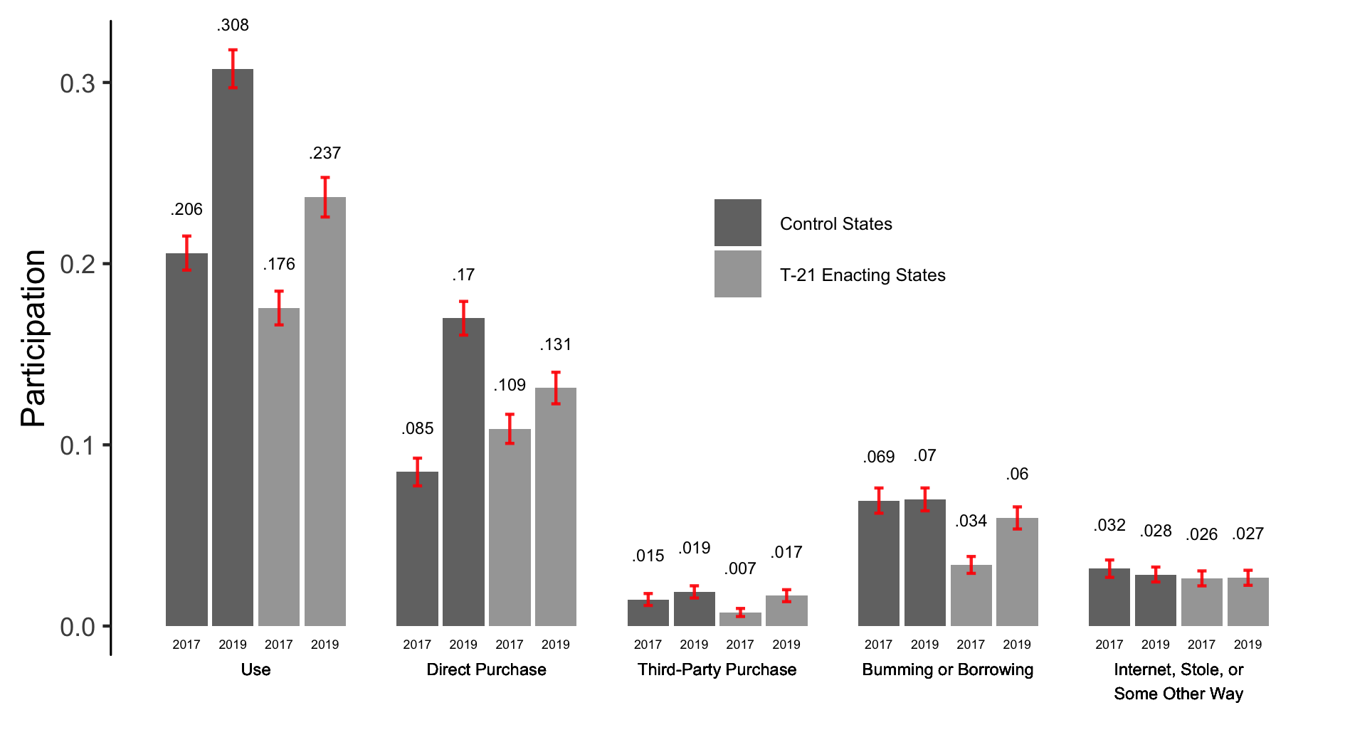
Usual Sources of Electronic Cigarettes

Slide 39
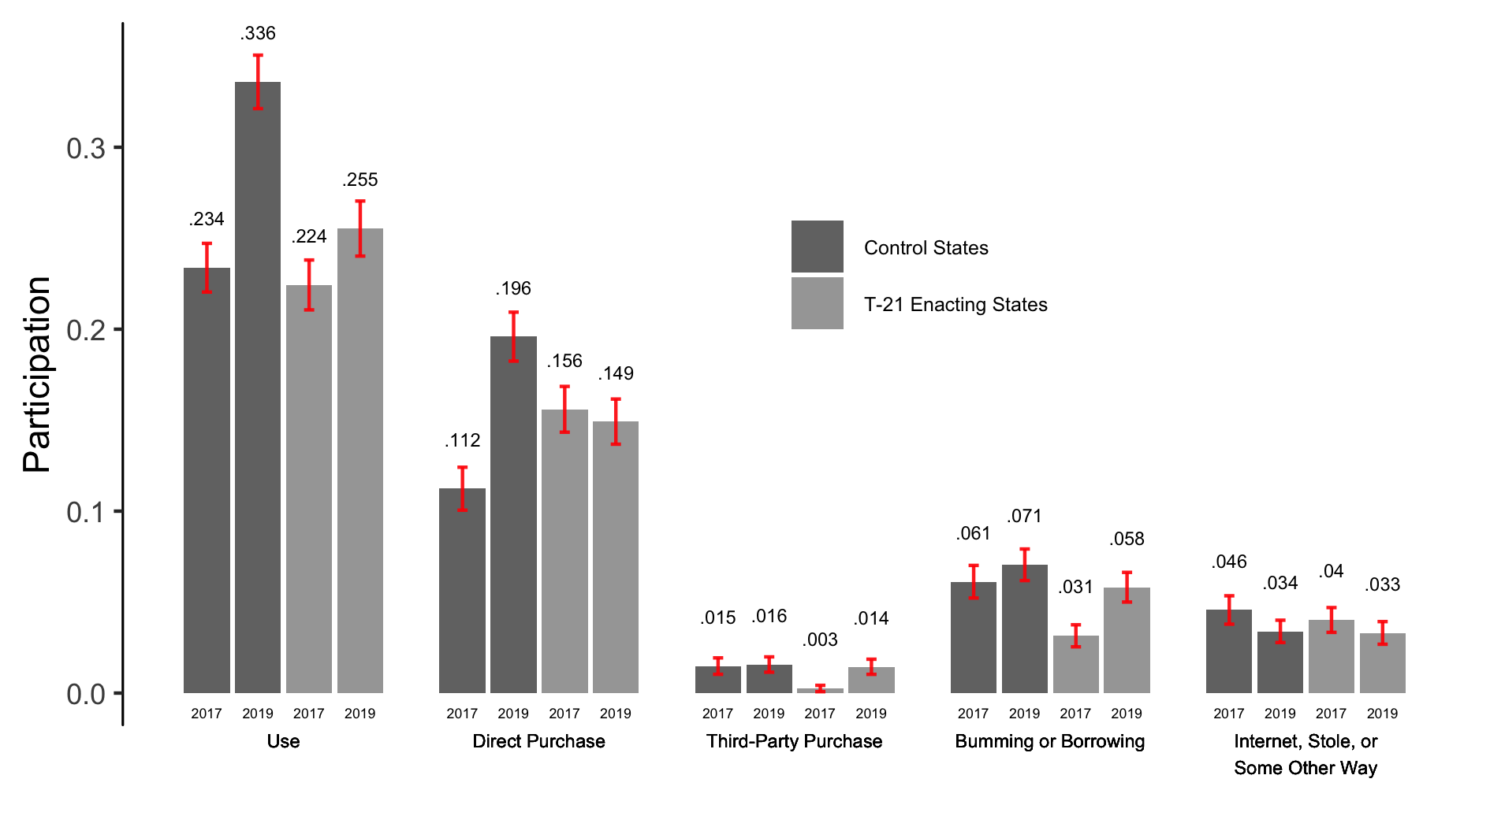
Even More Striking Among Males

Slide 40
Multinomial Logit Estimates: Usual Source of E-Cigarettes
 | Age 18 |  |  | Age 16-17
 | Panel I. Direct Purchase
Tobacco 21 Law | -0.157*** | -0.170*** | 0.030 |  | 0.047
 | (0.029) | (0.041) | (0.029) |  | (0.035)
Pre-Treat DV Mean | 0.109 | 0.109 | 0.018 |  | 0.018
 | Panel II: Third-Party Purchase
Tobacco 21 Law | -0.018 | -0.028 | 0.020 |  | 0.002
 | (0.014) | (0.016) | (0.021) |  | (0.023)
Pre-Treat DV Mean | 0.007 | 0.007 | 0.014 |  | 0.014
 | Panel III: Borrowing
Tobacco 21 Law | 0.105 | 0.176** | 0.063* |  | 0.045
 | (0.064) | (0.072) | (0.033) |  | (0.032)
Pre-Treat DV Mean | 0.035 | 0.035 | 0.059 |  | 0.059
 | Panel IV: Internet, Stole, or Some Other Way
Tobacco 21 Law | 0.007 | -0.001 | 0.003 |  | -0.007
 | (0.047) | (0.050) | (0.007) |  | (0.010)
Pre-Treat DV Mean | 0.026 | 0.026 | 0.025 |  | 0.025
Years | 2017-19 | 2017-19 | 2017-19 |  | 2017-19
Policy Controls? | N | Y | N |  | Y

Slide 41
Spillover Effects to Youth Marijuana Use (YRBS)
 | Panel I: Marijuana Use
Tobacco 21 Law | -0.035 | -0.052*** | -0.052***
 | (0.022) | (0.020) | (0.019)
Pre-Treat DV Mean | 0.276 | 0.276 | 0.276
 | Panel II: Frequent Marijuana Use
Tobacco 21 Law | -0.035** | -0.041** | -0.049***
 | (0.018) | (0.019) | (0.019)
Pre-Treat DV Mean | 0.129 | 0.129 | 0.129
Socioecon & Cigarette Policy Controls? | Y | Y | Y
Marijuana Polices? | N | Y | Y
Alcohol Policies? | N | N | Y

Slide 42
Spillover Effects to Alcohol (YRBS)
 | All | Males | Females
 | Panel I: Alcohol Use
Tobacco 21 Law | 0.052 | 0.045 | 0.060
 | (0.049) | (0.045) | (0.064)
Pre-Treat DV Mean | 0.460 | 0.477 | 0.442
 | Panel II: Alcohol Use > 2 Days in Last 30 Days | Drinking = 1
Tobacco 21 Law | -0.085* | -0.147** | -0.021
 | (0.047) | (0.069) | (0.053)
Pre-Treat DV Mean | 0.598 | 0.661 | 0.522
 | Panel III: Frequent Binge Drinking | Binge Drinking = 1
Tobacco 21 Law | -0.100** | -0.097 | -0.109*
 | (0.045) | (0.065) | (0.060)
Pre-Treat DV Mean | 0.222 | 0.244 | 0.188

Slide 43
Spillover Effects to Alcohol (BRFSS)
 | All | Males | Females
 | Panel I: Alcohol Use
Tobacco 21 Law | -0.018 | -0.016 | -0.017
 | (0.016) | (0.018) | (0.029)
Pre-Treat DV Mean | 0.353 | 0.370 | 0.334
 | Panel II: Number of Days of Alcohol Use
Tobacco 21 Law | -0.214 | -0.385** | -0.005
 | (0.143) | (0.189) | (0.232)
Pre-Treat DV Mean | 1.989 | 2.316 | 1.608
 | Panel III: Number of Days of Alcohol Use | Drinking = 1
Tobacco 21 Law | -0.329 | -0.820* | 0.190
 | (0.337) | (0.475) | (0.408)
Pre-Treat DV Mean | 5.644 | 6.269 | 4.832

Slide 44
Conclusions: Who Cares?
The Federal Tobacco to 21 Act was passed in December 2019
It will be at least somewhat difficult to disentangle the effects of the Federal T-21 law (which has not yet been fully implemented) from heterogeneous effects of the COVID-19 pandemic across states where it did and did not bind
This study provides important — and perhaps the best evidence we will have — on the effects of T-21 laws
Our results provide strong evidence that statewide T-21 laws are associated with important reductions in tobacco use among 18-to-20-year-olds
Includes both traditional cigarettes and e-cigarettes
Spillover effects to minors
Some suggestive evidence that access to the informal social market blunts the impact of T-21 laws on e-cigarette use among some 18-year-olds

Slide 45
Discussion
At present, the US is one of only a handful of counties to have a nationwide T-21 law
Ethiopia, Honduras, Philippines, Sri Lanka, Uganda, and US
US has far lower smoking rates than most OECD counties, so not clear on generalizability of this study internationally
Effects of T-21 laws are likely to vary with a number of factors
Local prices
Auditing programs to verify compliance with age requirements
Magnitudes of fines
Internet purchases (where age verification less) and cross-state border shopping (Merriman 2010; Goolsbee et al. 2010)

Slide 46
Will T-21 will be a long-run public health success?
U.S.-based tobacco companies endorsed T-21 in the end
Why? Perhaps to avoid regulation of flavored tobacco products (Myers 2019)
Revealed preference might suggest greater profits associated with less regulation of e-cigarettes
Losing sales to 18-20-year-olds may be worth retaining current and future smokers through flavored e-cigarettes
Some attribute to JuuL products having high nicotine content, appealing flavors, and more easily concealed (FDA 2018)
Dramatic tobacco market changes matters for designing optimal future policy
Master Settlement Agreement is 25 years old
Dramatic shift from traditional cigarettes to e-cigarettes
Advertising and targeting youths has moved to social media and distribution to online markets
Long-run impacts of T-21 will depend, in part, on how policy responds to changing markets and technological developments (both for evasion and enforcement)

